Slide 1
COST country update – Croatia
at COST FinAI Annual MC meeting
May 2024

Slide 2


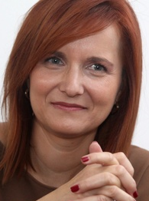
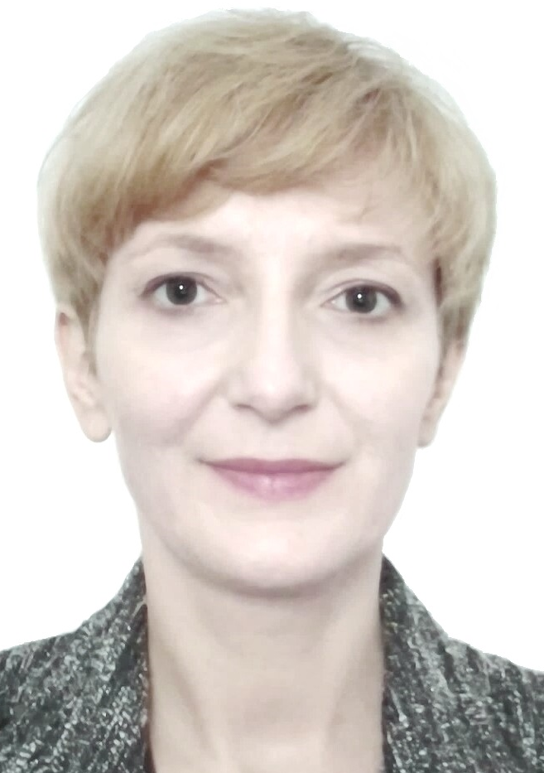


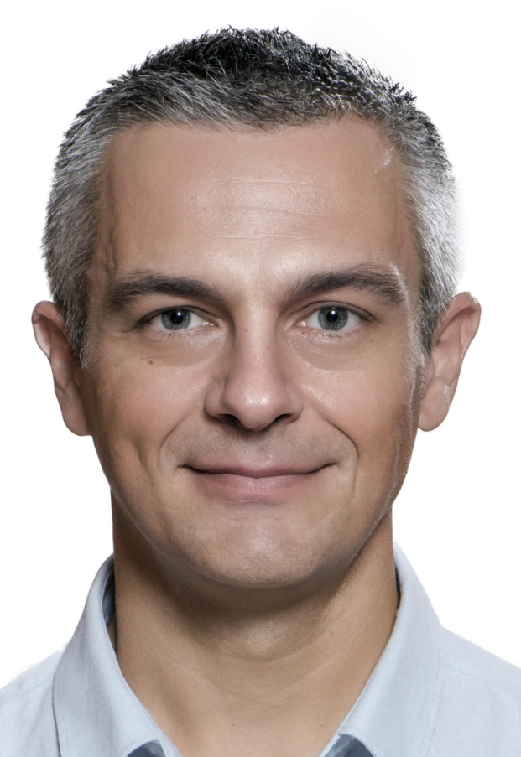

Martina
Solenicki
University of Zagreb
mnakic4@net.efzg.hr
Nika
Simurina
University of Zagreb
nsimurina@efzg.hr
Bozena
Gulija
Financial sector regulation
expert
bozena.gulija@outlook.com
Ana
Ivanisevic Hernaus
University of Zagreb
aivanisev@net.efzg.hr
Silvija
Vlah Jeric
University of Zagreb
svlah@efzg.hr
Domagoj
Sajter
University of Osijek
sajter@efzg.hr
Petra
Palic
Catholic University of Croatia
petra.palic@unicath.hr

Slide 3

International Scientific Conference Technology, Innovation and Stability: New Directions in Finance, May 5th - 6th 2022, Zagreb, Croatia (hybrid event)
Organised by COST FinAI, Faculty of Economics and Business – University of Zagreb and Croatian Academy of Sciences and Arts
COST FinAI members from 15 countries participated in the organisation of the event, research presentations and publications
Keynote: Manifold destiny: Unsupervised machine learning for the social sciences by professor James Ming Chen, Michigan State University, College of Law, USA
Invited talk: Overview of COST Action CA19130 FinAI - Fintech and Artificial Intelligence in Finance - Towards a Transparent Financial Industry by professor Jörg Osterrieder, Bern Business School, Institute of Applied Data Science and Finance, Switzerland
COST FinAI WG 2 meeting

Slide 4


International Scientific Conference Technology, Innovation and Stability: New Directions in Finance, May 5th - 6th 2022, Zagreb, Croatia (hybrid event)
Panel discussion FinTech in 2022 and beyond: Possibilities and new regulatory challenges
Simurina, N., statement for Business Plan, TV show at Croatian Radiotelevision
Event’s web: https://sites.google.com/net.efzg.hr/tinfinconference/home?authuser=0
Event’s publications: Book of Abstracts and Conference Proceedings (full papers)
Book of Abstracts and Conference Proceedings available at:
https://sites.google.com/net.efzg.hr/tinfinconference/programme/conference-proceedings?authuser=0
https://sites.google.com/net.efzg.hr/tinfinconference/programme/book-of-abstracts?authuser=0

Slide 5
Selected publications (research and professional papers)
Dzelalija, P., Ivanisevic Hernaus, A. (2023). From Perceived Mobility to the Intention to Use Mobile Payments: The Role of Positive and Negative Determinants. In: van Hillegersberg et al. (Eds.) Enterprise Applications, Markets and Services in the Finance Industry, 11th International Workshop, FinanceCom 2022, Twente, The Netherlands, August 23–24, 2022, p.117-132, LNBIP 467, Springer
Gulija, B (2022). New financial sector regulatory update - sustainability and digitalisation. Financial Regulation International (Informa), 25(7), Retrieved 14 October 2022
Gulija, B. (2022). Global initiatives regarding prudential treatment of banks' cryptoasset exposures. Financial Regulation International (Informa), 25(3), Retrieved 30 April 2022

Slide 6
Selected publications (research and professional papers)
Ivanisevic Hernaus, A., Kristo, J., Rako, R. (2023). ESG-Related Challenges in the Insurance Industry: A Multi-Stakeholder Perspective. In: Druzic, G. et al. (Eds.), Proceedings of the International Scientific Conference Technology, Innovation and Stability: New Directions in Finance (TINFIN), p.33-58. Zagreb: Faculty of Economics and Business
Ivanisevic Hernaus, A., Zoricic, D., Dolinar, D. (2023) How competitive is SRI in developing financial markets: The case of Central and Eastern Europe, E&M Economics and Management, 26(2), p.172–188. DOI: doi.org/10.15240/tul/001/2023-2-011
Jurcevic, J., Vlah Jeric, S., Zoricic, D. (2023) Electricity prices forecasting on the day-ahead market – performance comparison of selected machine learning models, 12th International Scientific Symposium Region, Entrepreneurship, Development, Osijek, Croatia, p.591-602
Kencek, M., Ivanisevic Hernaus, A. (2024). Getting From Today to Tomorrow: What Determines the (Intent-to)-Use Digital Banking Services? Conference Proceedings of the 5th International Conference on the Economics of Decoupling (ICED) 2024, ISSN 2718-3092 (Online), p.217–234.

Slide 7
Selected publications (research and professional papers)
Kurnoga, N., Simurina, N., Fuckan, F. (2022). Performance Differences between ESG Indices and Conventional Market Indices: a Multivariate Analysis of Indices, Zagreb International Review of Economics & Business, 25, p.85-103. Zagreb: Faculty of Economics and Business. DOI:10.2478/zireb-2022-0026
Ming Chen, J,. Simurina, N., Solenicki, M. (2024) Le rouge, le noir, et l'inégalité: Tax policy and inequality in the European Union, Frontiers in Applied Mathematics and Statistics, section Mathematical Finance, Vol.9, Research Topic: Advanced Statistical Modelling for Fintech, Financial Inclusion, and Inequality (3 January 2024), DOI: 10.3389/fams.2023.1282975
Sajter, D. (2022). Overseas Transaction Fees: Sending Money via Bitcoin vs. Banks. Zagreb International Review of Economics & Business, 25(SCI), p.65-83
Sajter, D. (2022). Blockchain applications and Decentralized Finance. In: Vlachý, J. (ed.) Financial Markets and Risk Management (1st ed.) Praha: UCT. ISBN 978-80-7592-151-2. Available at: https://vscht.futurebooks.cz/book/fmrm/?/appendix-a-blockchain-applications-and-decentralized-finance/

Slide 8
Selected publications (research and professional papers)
Sajter, D. (2024). Trendovi i teme u hrvatskoj ekonomskoj znanosti/Trends and topics in Croatian economic science. Ekonomska misao i praksa/ Economic Thought and Practice. Available at: https://hrcak.srce.hr/clanak/450152
Vlah Jeric, S. (2023) Time interval choices in forecasting stock market indices of CEE and SEE countries. Post-Communist Economies, 35(4), p. 403-413, DOI: 10.1080/14631377.2023.2188768
Vlah Jeric, S.(2023) Analysis of the financial performance of machine learning models for predicting the direction of change of CEE and SEE stock indices with different classifier evaluation metrics. Ekonomska misao i praksa/Economic Thought and Practice, Ekonomska misao i praksa, 32 (2), 533-545. https://doi.org/10.17818/EMIP/2023/2.12
Vujeva, K., Solenicki, M. (2023) Private Money Creation in the Age of Financial Globalization. In: Druzic, G. et al. (Eds.), Proceedings of the International Scientific Conference Technology, Innovation and Stability: New Directions in Finance (TINFIN), p.113-153. Zagreb: Faculty of Economics and Business

Slide 9
Selected work-in-progress (research publications)
Vlah Jeric, S. - a discussion paper for possible approaches to building a statistically valid back-testing framework, joint paper with COST FinAI members (lead by professor Kristina Šutienė)
Vlah Jeric, S. - Network evolution analysis of the Croatian Stock Market (Topological dynamics of the Croatian Stock Market), presented at the 45th EBES Conference - Budapest

Slide 10
Education, teaching, university textbooks
Blockchain and Decentralized Finance, a new course in the Graduate study programme at the J. J. Strossmayer University of Osijek, Faculty of Economics in Osijek (introduced by Sajter, D., course coordinator). The brochure of the new program is available at: http://www.efos.unios.hr/wp-content/uploads/2023/07/EFOS_Web_Brosura_FinancijskiMenadzment.pdf
Innovative Financing and Technologies for the Inclusive Economy at the Economy of Francesco International Summer School Split 2023, organised by Economy of Francesco Croatia, Catholic university of Croatia, Faculty of social sciences Angelicum, Docat Center Split (prepared and delivered by Sajter, D.)
Summer starts with ESG, education organised by the University of Zagreb, Faculty of Economics & Business, and Zagrebacka Bank- part of Unicredit group (prepared and delivered by Simurina, N. and Solenicki, M.)
FinTech Companies. In: Stojanovic, A. (Ed.), Financial Institutions and Markets, university textbook in the Integrated undergraduate and graduate university study programme, University of Zagreb, Faculty of Economics & Business (book chapter in-progress by Ivanisevic Hernaus, A.)
Applied Machine Learning, a new course at the Integrated Undergraduate and Graduate study programme at the Faculty of Economics, University of Zagreb (Silvija Vlah Jerić is course coordinator). The brochure of the new program is available at: https://drive.google.com/file/d/1XcyQkr0NoYFy6pDIvr6V0XlnS6E9jMJP/view)

Slide 11
Deepening the connection with academia, regulatory institutions and industry: Speeches, lectures, participation in roundtables
Gulija, B. – Speaker at the Markus Evans annual conference on Capital Management for Banking Institutions, agreed to be held on 29 November – 1 December 2023, London (one of the topics Bozena will cover is prudential treatment of cryptoassets)
Gulija, B. – Participant and one of the chairs at the roundtable organised by the University of Warwick, 15 September 2023, „European banks and exogenous shocks: What are the lessons for future crisis prevention and management frameworks?“ (one of the sessions was dedicated to cybersecurity)
Gulija, B. – Speaker at the Risk.net/Risk Learning (Infopro Digital) course on Basel IV, 6-8 September 2023, online (one of the topics Bozena covered was prudential treatment of cryptoassets)
Gulija, B. – Speaker at the Risk.net/Risk Learning (Infopro Digital) course on Basel IV, 20-23 March 2023, online (one of the topics Bozena covered was prudential treatment of cryptoassets)
Gulija, B. – Speaker at the Central Banking (Windsor virtual series) event on Macro-prudential policy, 27 February – 2 March 2023 (one of the topics Bozena covered was prudential treatment of cryptoassets)
Gulija, B. – Lecture on Fintech in the regulatory context, for Arcada University of Applied Sciencies, Finland, 12 January 2023

